Slide 1
TRANSFORMER
Slides by Vaswani, Ashish, et al. "Attention is all you need." Advances in neural information processing systems. 2017.

Slide 2
OUTLINES
INTRODUCTION
MODEL ARCHITECTURE

Slide 3
INTRODUCTION
The Transformer – a model that uses attention to boost the speed with which these models can be trained. It was proposed in the paper Attention is All You Need.
The Transformers outperforms the Google Neural Machine Translation model in specific tasks. The biggest benefit is how The Transformer lends itself to parallelization.
It is in fact Google Cloud’s recommendation to use The Transformer as a reference model to use their Cloud TPU offering.

Slide 4
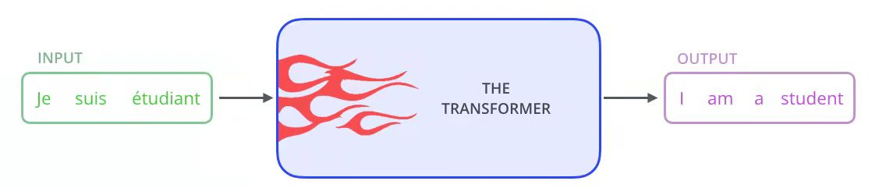
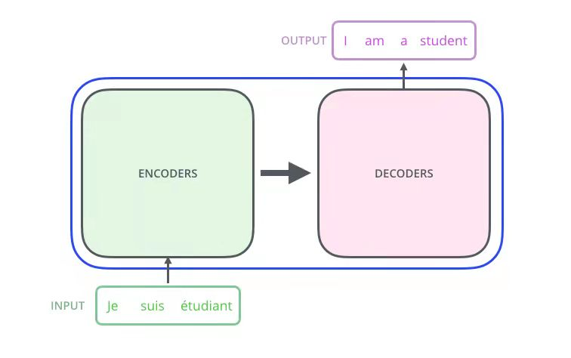
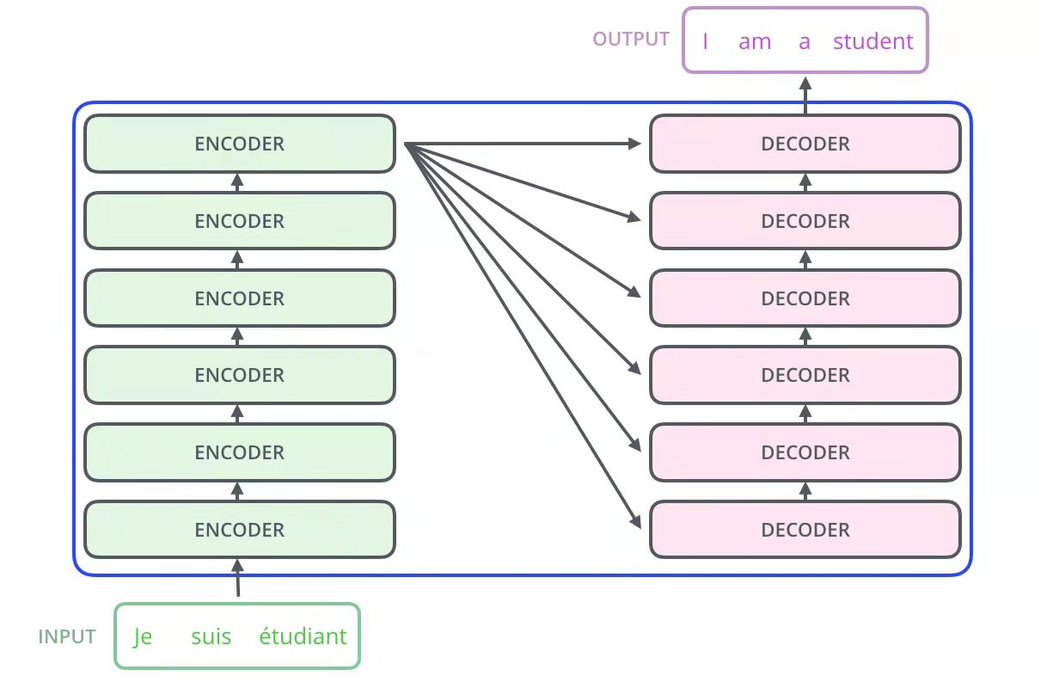
MODEL ARCHITECTURE
Sourses:https://jalammar.github.io/illustrated-transformer/

Slide 5
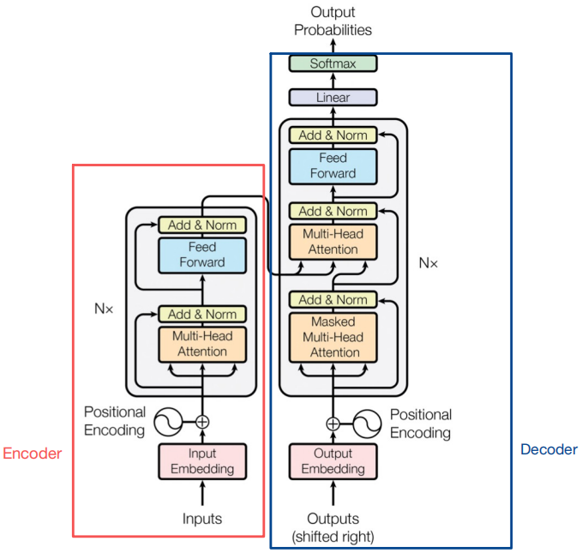

Sourses:https://jalammar.github.io/illustrated-transformer/

Slide 6
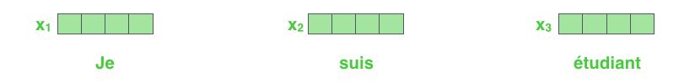
Embedding Algorithm
The embedding only happens in the bottom-most encoder.
The abstraction that is common to all the encoders is that they receive a list of vectors each of the size 512.
The size of this list is hyperparameter we can set – basically it would be the length of the longest sentence in our training dataset.

Slide 7
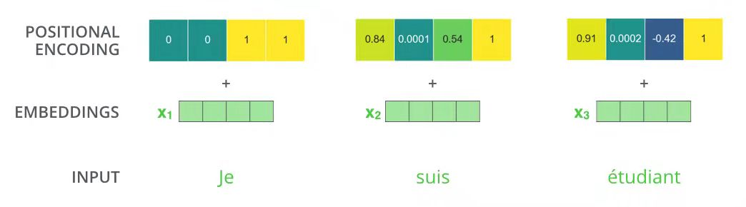
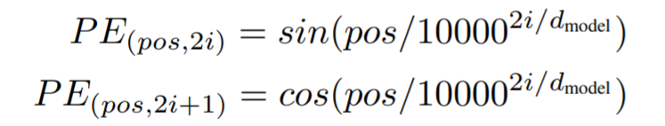
Positional Encoding
Since our model contains no recurrence and no convolution, in order for the model to make use of the order of the sequence, we must inject some information about the relative or absolute position of the tokens in the sequence.
To this end, we add "positional encodings" to the input embeddings at the bottoms of the encoder and decoder stacks.
pos is the position and i is the dimension

Slide 8
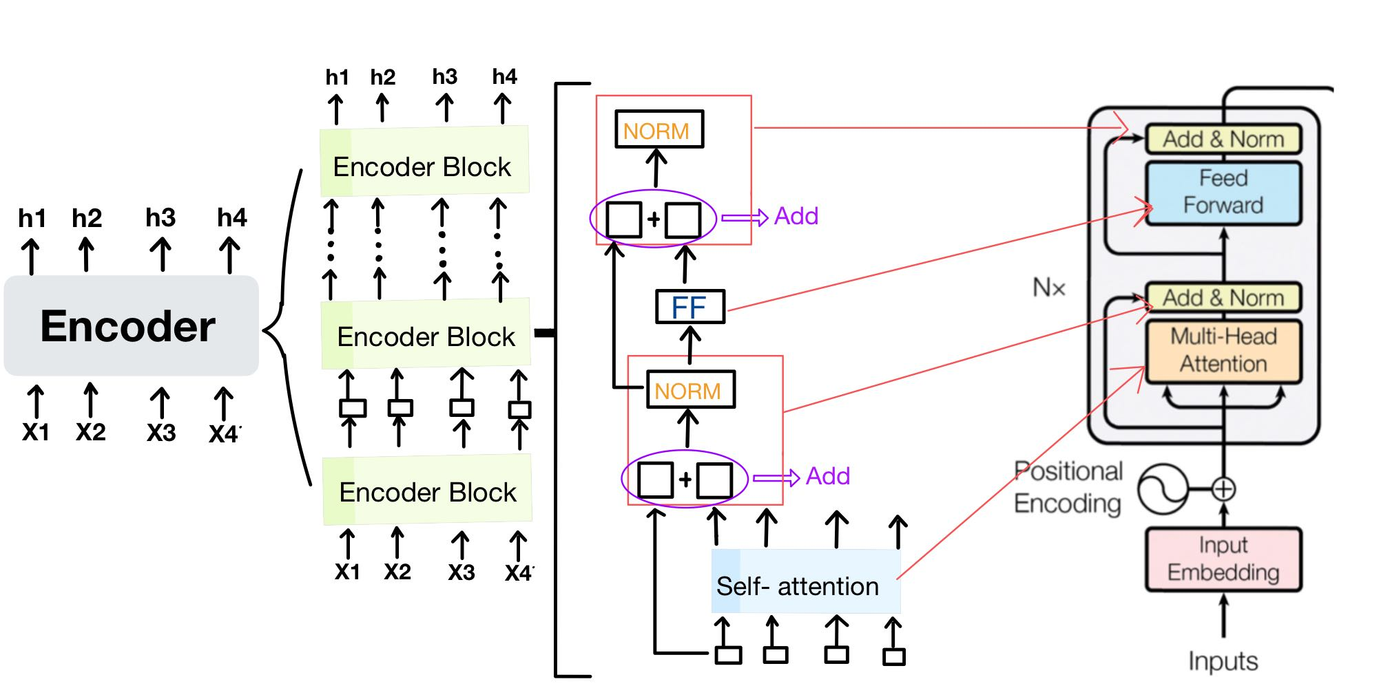
Encoder
The encoder is composed of a stack of N = 6 identical layers.
Each layer has two sub-layers. The first is a multi-head self-attention mechanism, and the second is a simple, positionwise fully connected feed-forward network.
The output of each sub-layer is LayerNorm(x + Sublayer(x)). where Sublayer(x) is the function implemented by the sub-layer itself.

Slide 9
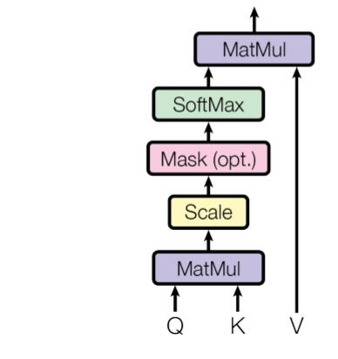
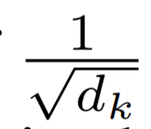
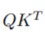
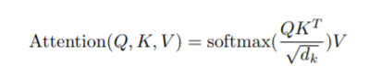
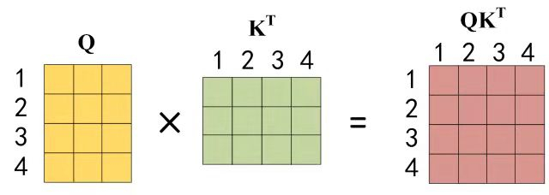
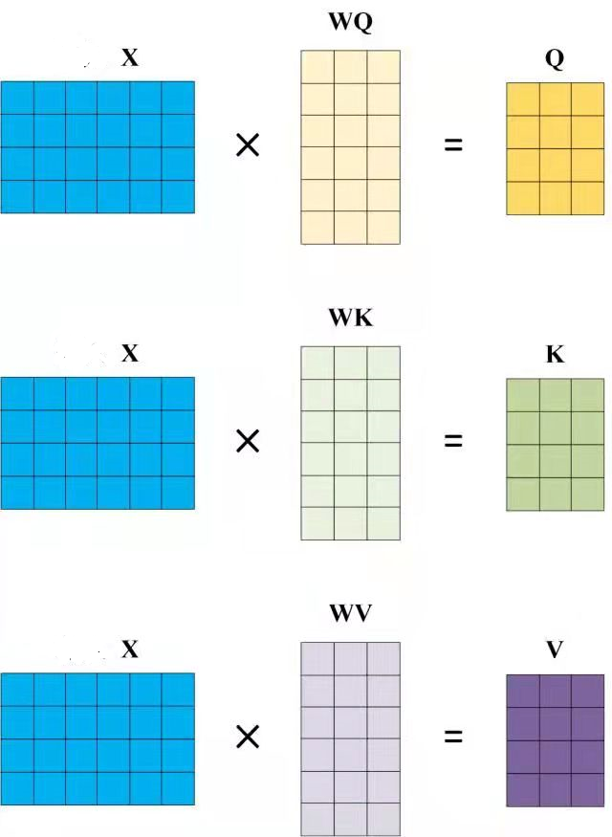
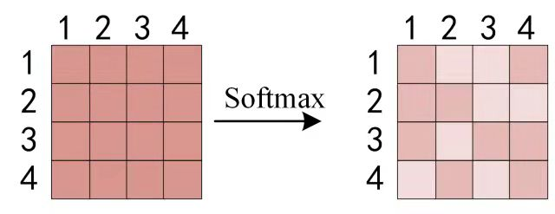
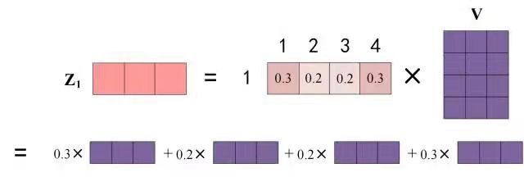
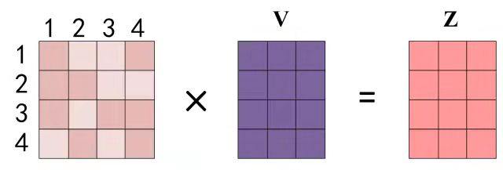

Self- Attention
We call our particular attention "Scaled Dot-Product Attention"
The input consists of queries and keys of dimension dk, and values of dimension dv.
Step 1:
Step 2:

Slide 10
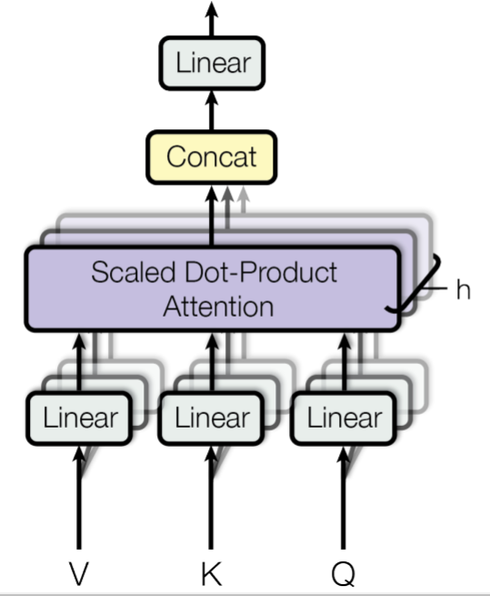
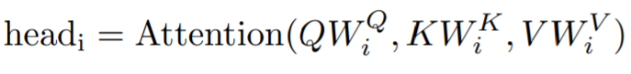
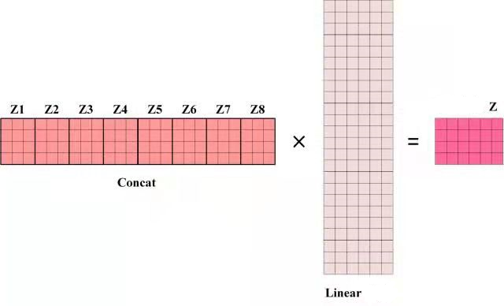
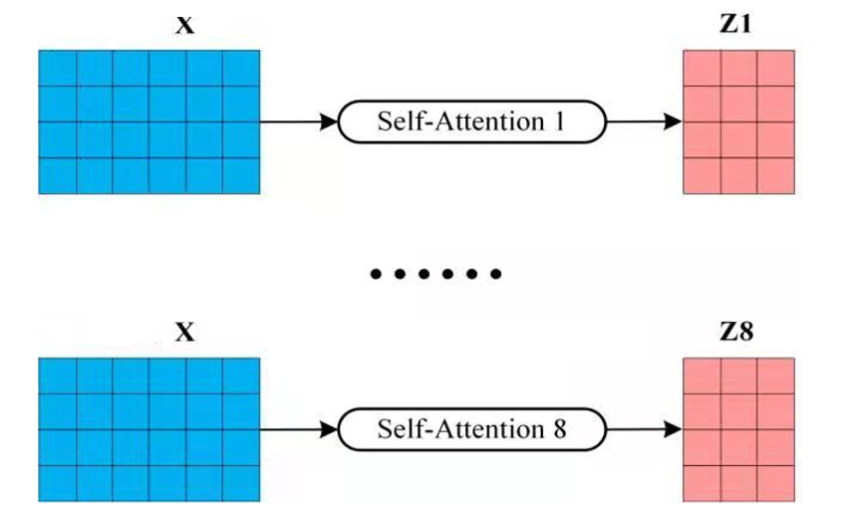
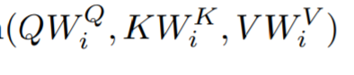
Multi-Head Attention
Step 1: input V, K, Q and Linear
Step 2:
Step 3:

Slide 11
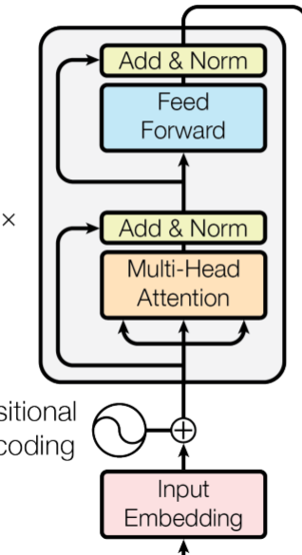
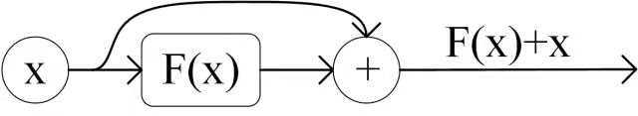
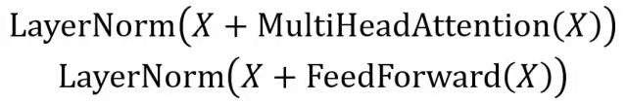
ADD & NORM
ADD:
NORM:

Slide 12
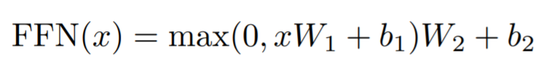
Fully connected Feed-Forward network
Each of the layers in our encoder and decoder contains a fully connected feed-forward network, which is applied to each position separately and identically. This consists of two linear transformations with a ReLU activation in between.

Slide 13
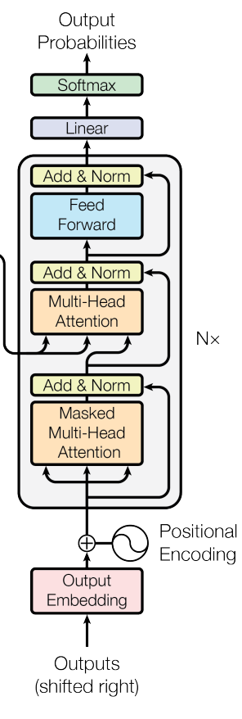

Decoder
Decoder
Encoder
Decoder Output

Slide 14
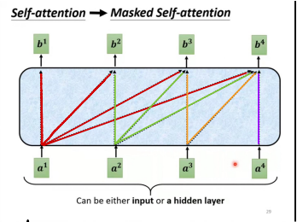
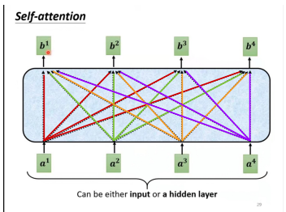
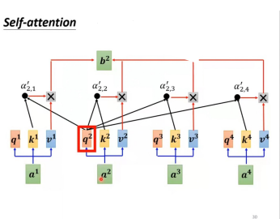
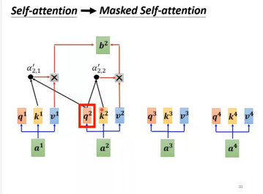
Mask Multi-Head Attention
The reason for using Masked is the process of translation is in sequence.
Which means the i+1th vocabulary will be translated after the nth vocabulary translated.
VS.
VS.

Slide 15
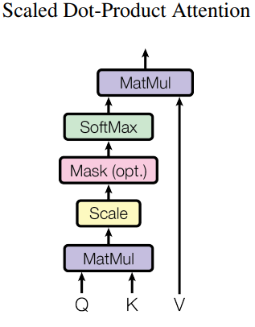
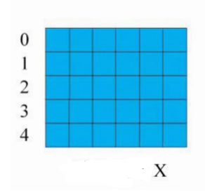
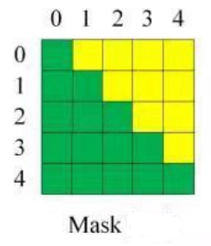
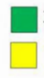
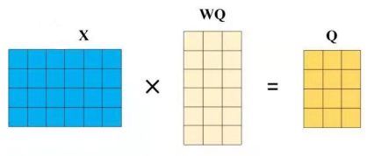
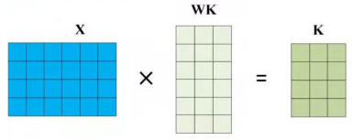
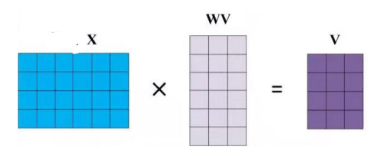
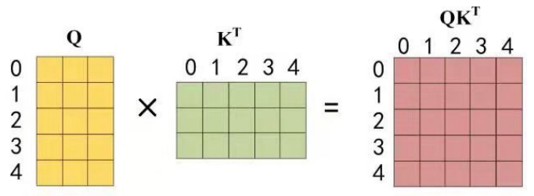
I Have A Pretty Cat
0 1 2 3 4
Step1: Get Input matrix and Mask matrix
No Masked
Vocabulary 0 can just use the information for itself.
Masked
Vocabulary 1 can use information from 1 and 0.
Input Matrix
Step2: Get Q, K, V
Step3: MatMul

Slide 16
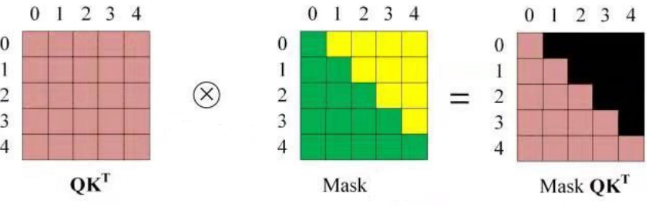
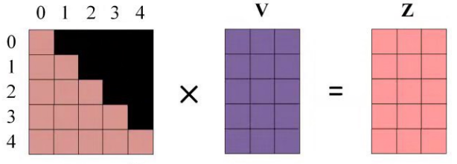
Step4: Use Mask Matrix to Mask QK^(T)
Step5: SoftMax
Step6: Get (Mask QK^(T))V
The output vector Z for Vocabulary 1 will just include information from vocabulary 1
Step7: Same step with Multi-attention, concat, Linear

Slide 17
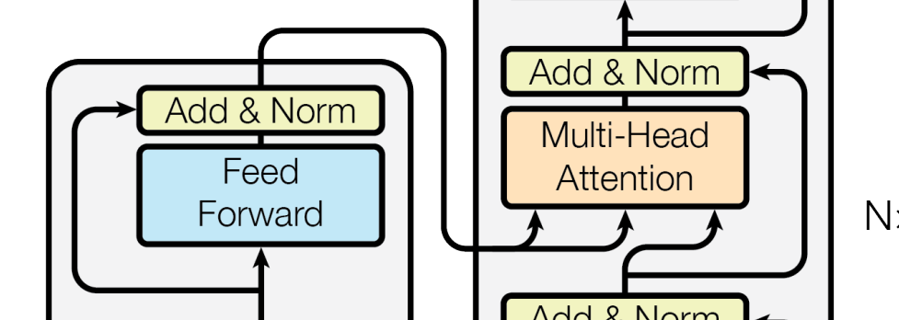
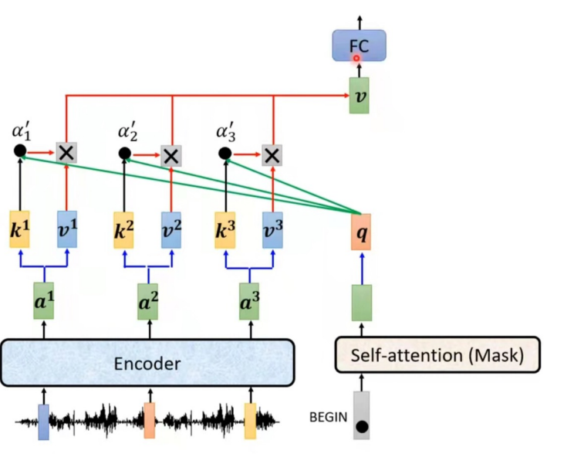
The difference between self-attention is Decoder and self-attention in encoder is:
Self-attention in Decoder will get K and V from encoder.
The reason is every vocabulary will use all vocabulary’s information from Encoder
Sourses:https://jalammar.github.io/illustrated-transformer/

Slide 18
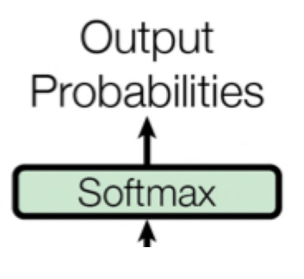
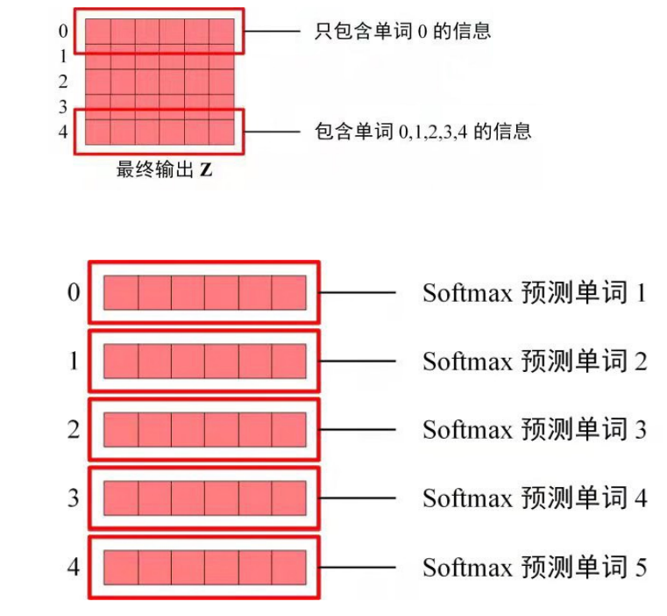
Softmax
Just include V 0’s information
include V 0,1,2,3,4 ’s information
Final Output z
Predict V 1
Predict V 2
Predict V 3
Predict V 4
Predict V 5

Slide 19
Reference
[1] Vaswani A, Shazeer N, Parmar N, et al. Attention is all you need [C]//Advances in Neural Information Processing Systems. 2017: 5998-6008.
[2] Bahdanau D, Cho K, Bengio Y. Neural machine translation by jointly learning to align and translate[J]. arXiv preprint arXiv:1409.0473, 2014.
[3] Devlin J, Chang M W, Lee K, et al. BERT: Pre-training of Deep Bidirectional Transformers for Language Understanding[J]. arXiv preprint arXiv:1810.04805, 2018.
[4] http://jalammar.github.io/illustrated-transformer
[5] He K, Zhang X, Ren S, et al. Deep residual learning for image recognition[C]//Proceedings of the IEEE conference on computer vision and pattern recognition. 2016: 770-778.

